Slide 1
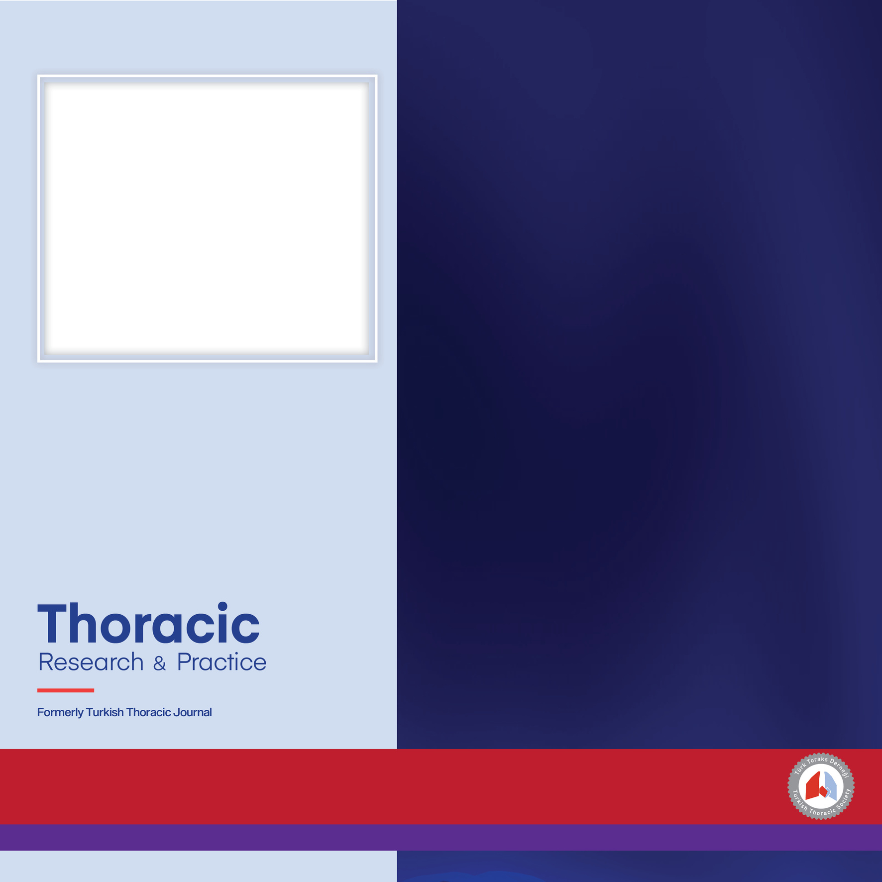
Article Title:
Short title reflecting the main outcome (max. 4–5 words).
For studies that do not include any figures*:
Converting a relevant table into a visual format,
Creating a data-driven visual using NotebookLM or similar AI tools,
Generating a visual solely through NotebookLM or similar AI tools.
Aim: Primary objective of the study in one concise sentence.
Methods: Study design and main method (e.g., sample size, study type, key analysis).
Key Results: One or two principal findings with essential data.
Lower Area: Brief, keyword-style caption for Figure.
Thoracic Research and Practice
Bottom Band: Date / Issue / Website

